Slide 1

Instacart Market Basket Analysis
-- FINAL PRESENTATION
Team 4: Chandni Narang
Chakradhar Rajaneni
Kun Guo
Pei Tang
Raghu Nandhan Rajendran

Slide 2

1
Introduction
2
Data Description
3
Data Exploration
4
Modeling
AGENDA
5
Findings and Recommendation

Slide 3

1
INTRODUCTION
BACKGROUND & BUSINESS VALUE

Slide 4
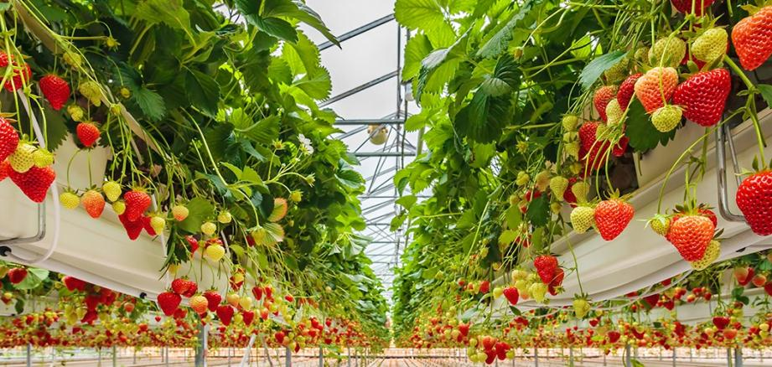
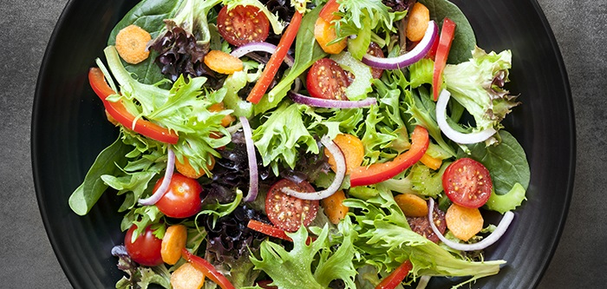
BACKGROUND
Founded in 2012, Instacart is an American company valued at nearly $8 billion that operates as a same-day grocery delivery and pick-up service in the U.S. and Canada.
Instacart's customers can access the service via the Instacart mobile app or website and begin shopping by selecting their city and store, then adding groceries to their digital cart. The order is shopped and delivered by an Instacart personal shopper.
It aims to make it easy to fill your refrigerator with your personal favorites food and staples when you need them.
In order to better fulfilled their services and enhance the efficiency at the customers check out time. Basically, they stored the customer order information in sequential order not only based on the transaction time but also they stored the sequence of products that customers put into their baskets within one order.

Slide 5
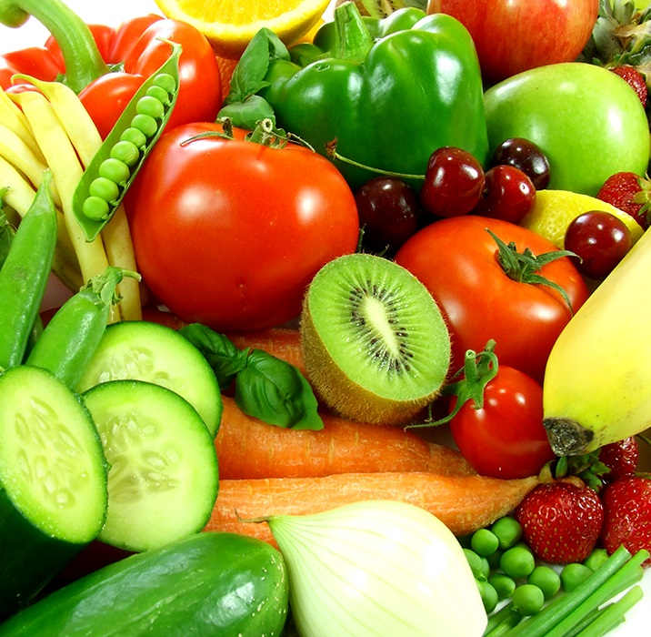
点击添加相关标题文字
BUSINESS VALUE
Understanding and learning Consumer Behavior
1
2
Saving Time on Searching Items
3
Increase Conversion and Revenue
4
Maintain Their Members and Attract New Customers
5
Better Target Marketing

Slide 6
2
DATA DESCRIPTION
& BASIC STATS

Slide 7
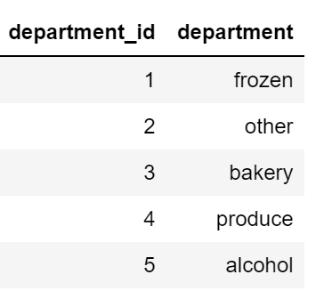
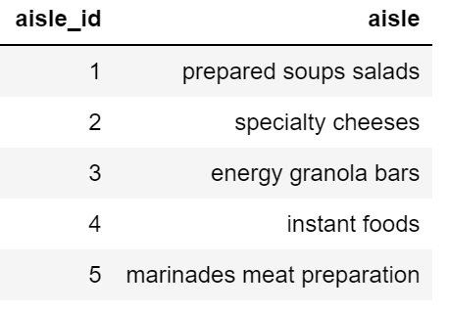
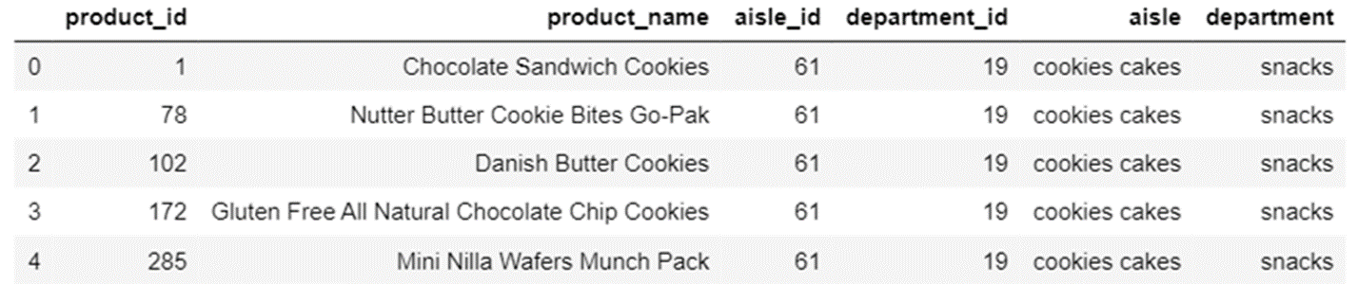

DATA DICTIONARY
AISLES
DEPARTMENT
Total: 21 departments
Total :134 aisles
Total: 49,688 products

Slide 8
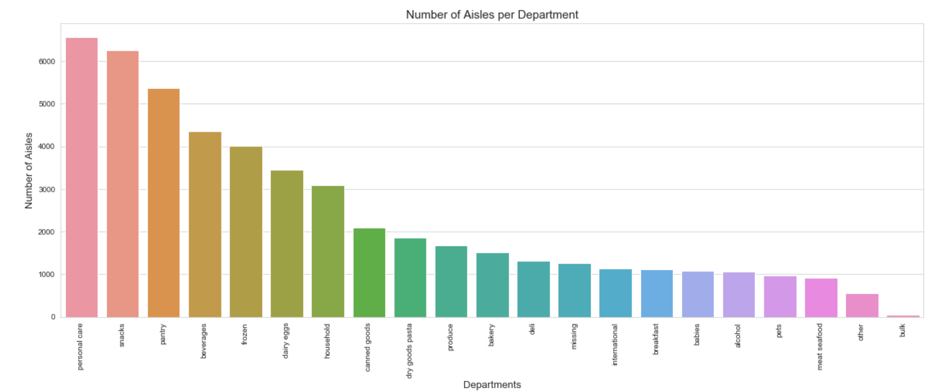
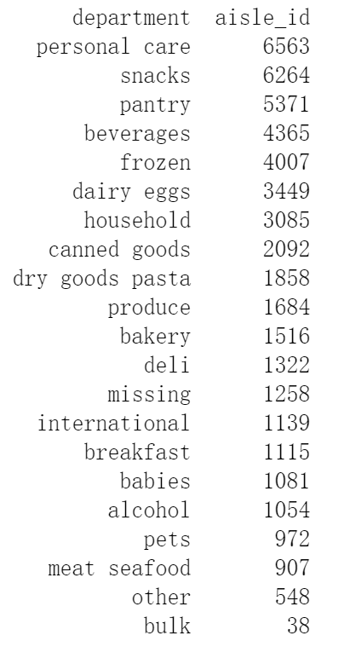
BASIC STATS: Products Distribution In 21 Departments

Slide 9
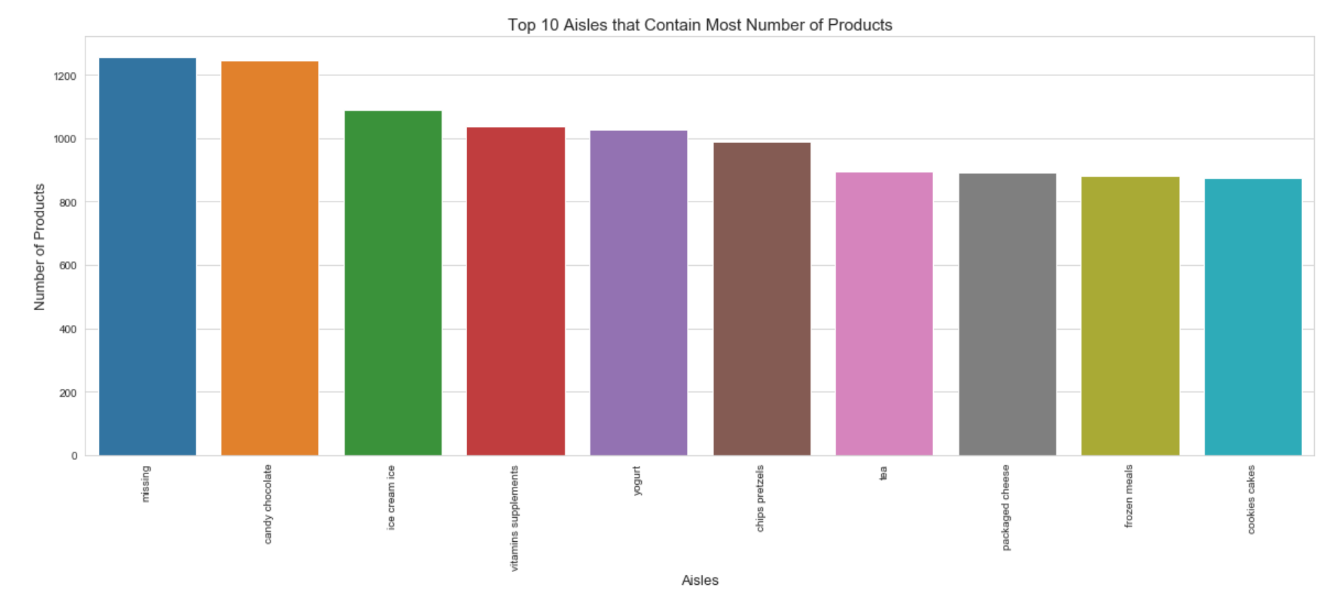
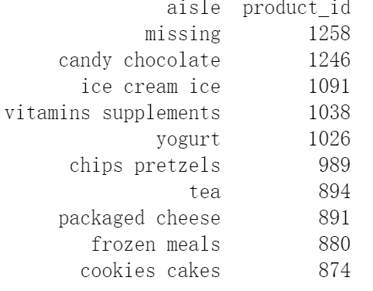
BASIC STATS: Ranking Aisles By Number of Products

Slide 10
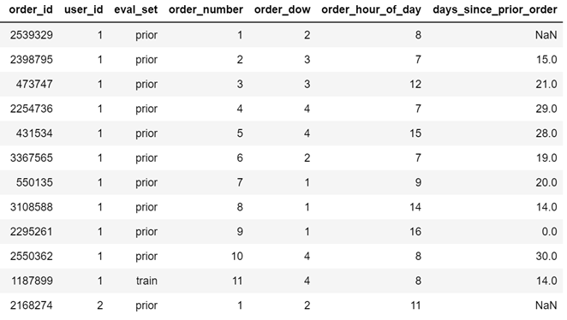

DATA DICTIONARY
Attribute | Definition
order_id | Unique ID for each order
user_id | Unique ID for each customer
eval_set | Dividing customers into prior, train and test
order_number | Number of orders for each customer
order_dow | Day of the week on which order is made
order_hours_of_day | Hour of the day in which order is made
days_since_prior_order | Interval days between prior order and next order
Over 3 Million Total Orders
Over 200,000 Number of Customers
Notes:
This file gives a list of all orders we have in the dataset. 1 row per order. (Giving definitions of all attributes) Days since prior order: Interval days between prior order and next order. For example, there’s 15 days interval between first order and second order for user id 1.
Overall, by looking at the dataset, we can see that for user id 1 has 11 orders in total, 1 of which is in the train set, and 10 of which are prior orders. The orders.csv doesn’t tell us about which products were ordered. This is contained in the order_products.csv

Slide 11
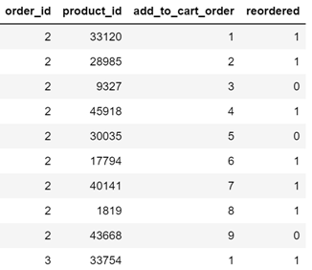
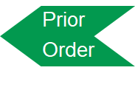
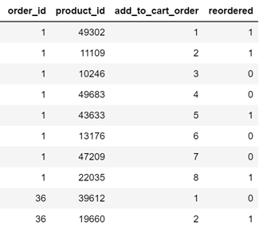
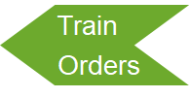
DATA DICTIONARY
Attribute | Definition
order_id | Unique ID for each order
product_id | Unique ID for each product
add_to_cart_order | Sequence of product that customer put into the cart per order
reordered | Whether of the product has been bought before (0 or 1)
Notes:
This file gives us information about which products (product_id) were purchased for each order. It also contains information of the order (add_to_cart_order) in which the products were put into the cart and information of whether this product is a re-order(1) or not(0).
For example, we see below that order_id 2 had 9 products, 6 of which are reorders.
We will use these 2 datasets for our further modeling

Slide 12
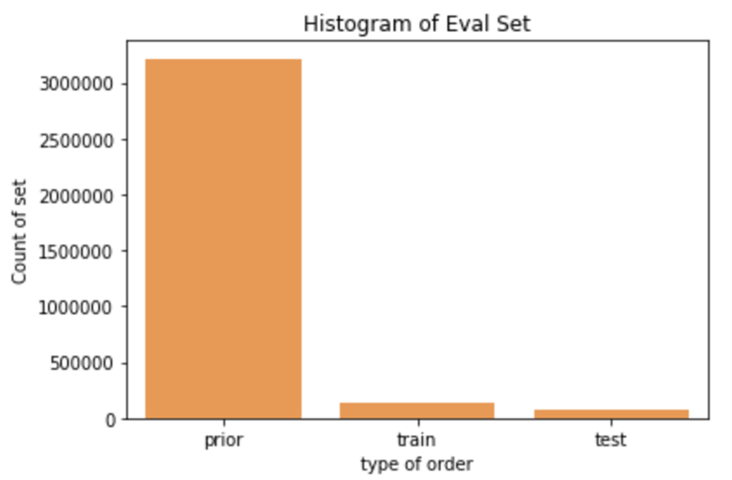
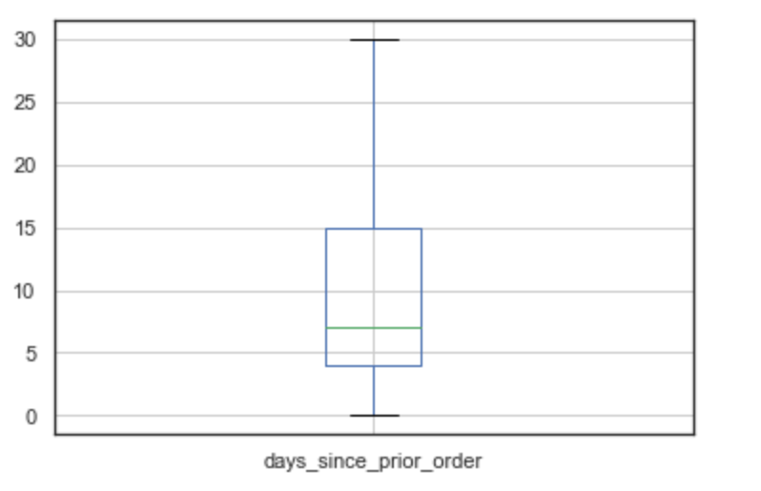
BASIC STATS
Median of Days Since Prior Order
Prior dataset | 3,421,083
Training dataset | 131,209
Test dataset | 75,000
Total number of customers | 206,209
Median of Days since prior order is 7
Therefore, people are ordering weekly

Slide 13
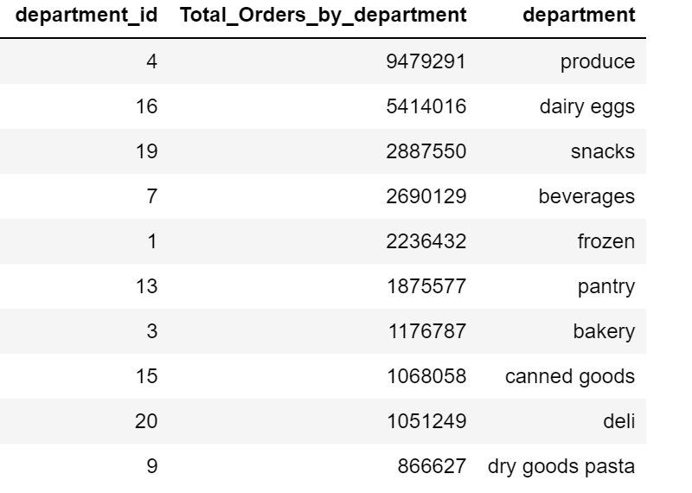
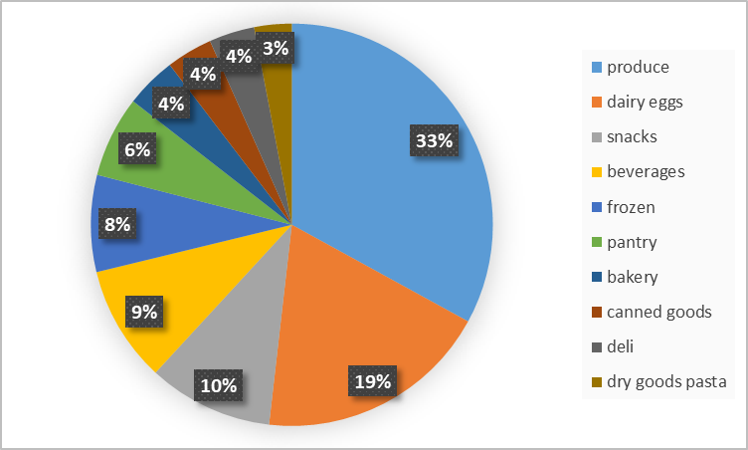
Top 10 Departments With Best Selling Products

Slide 14
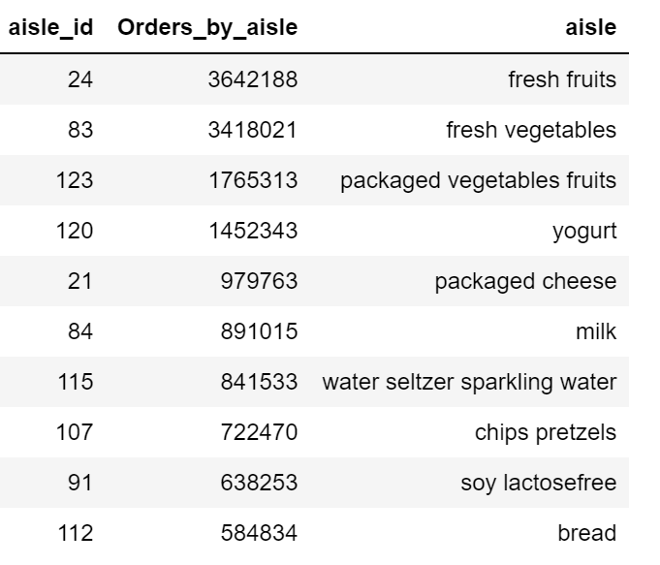
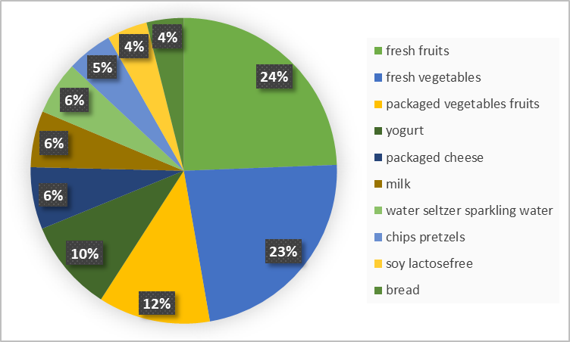
Top 10 Aisles With Best Selling Products

Slide 15
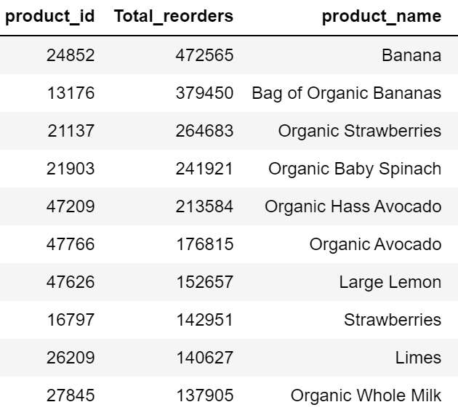
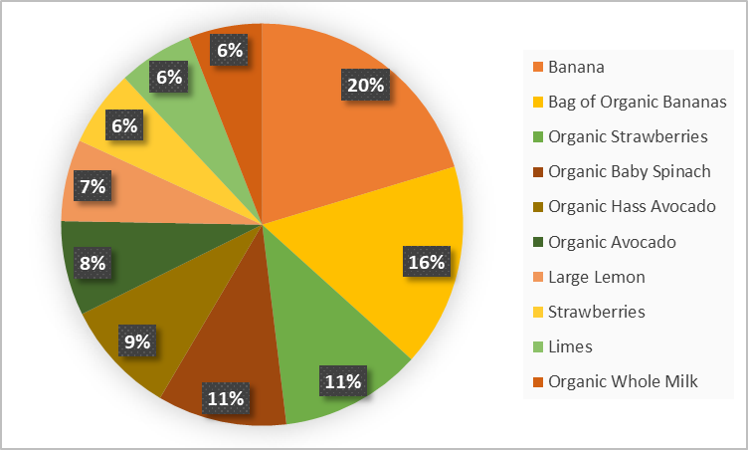
Top 10 Best Selling Products

Slide 16
3
DATA EXPLORATION

Slide 17
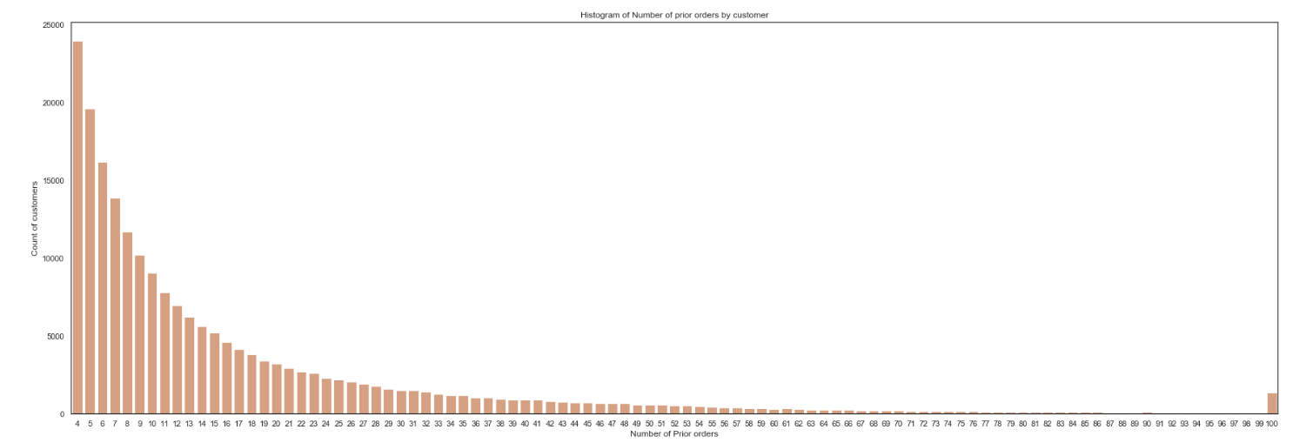
Number of Orders by Each Customer

Slide 18
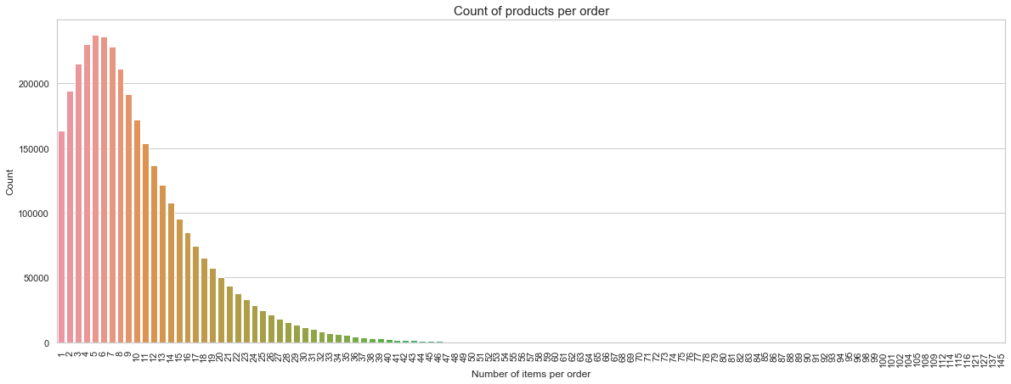
Products per Order

Slide 19
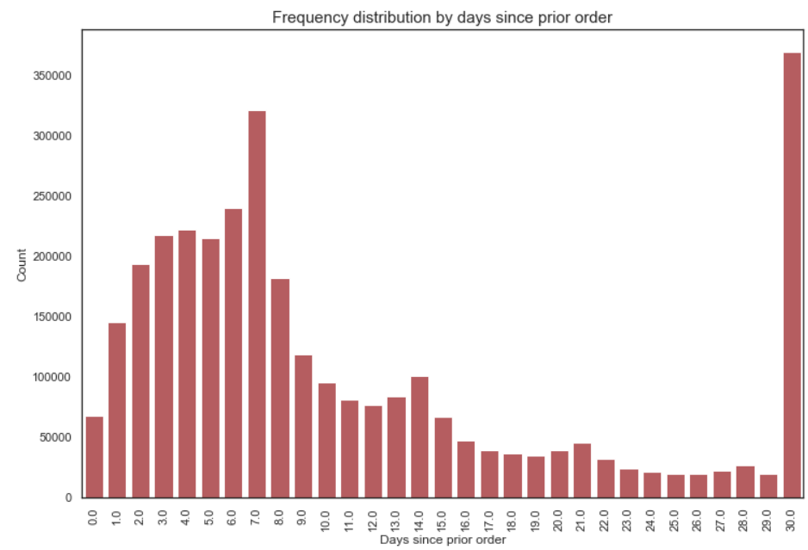
Frequency of Order

Slide 20
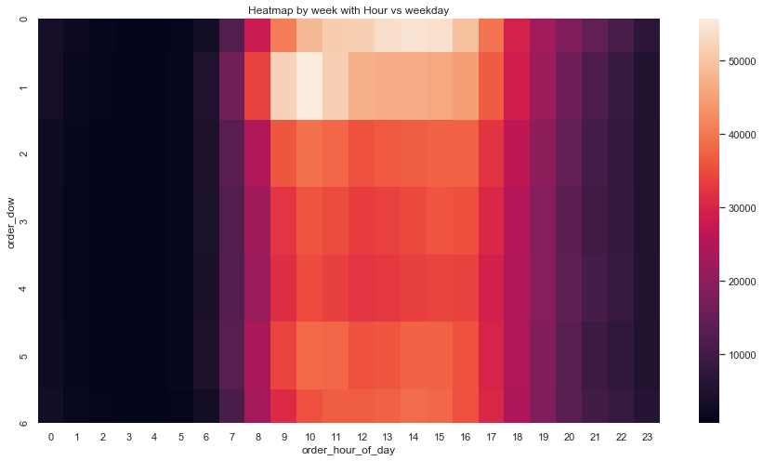
Traffic to Website in a Week

Slide 21
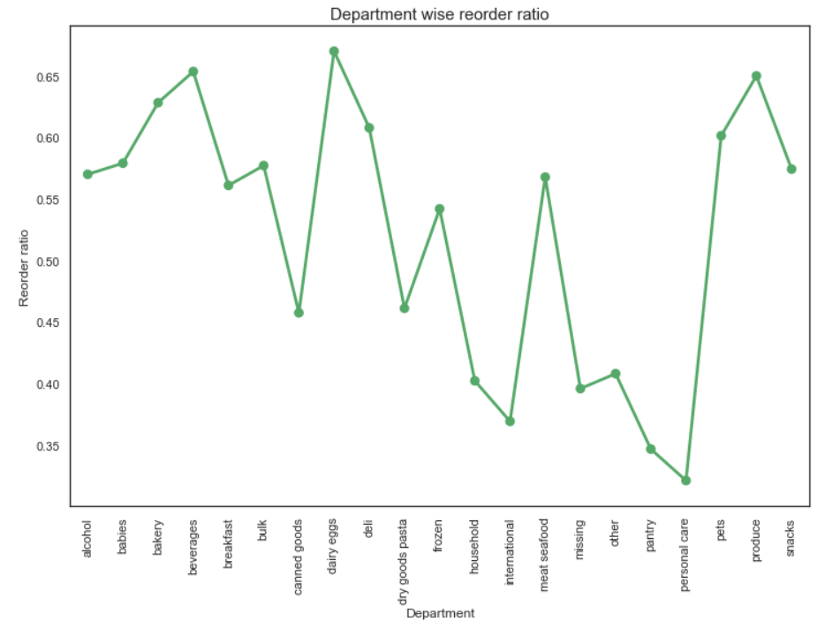
Reorder Ratio By Department

Slide 22
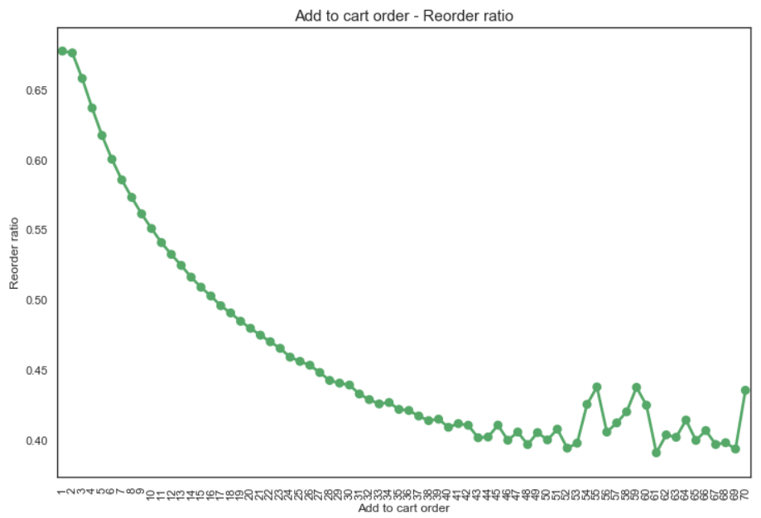
Reorder Ratio By Add-to-cart Order

Slide 23
4
MODELING
UNSUPERVISED LEARNING

Slide 24
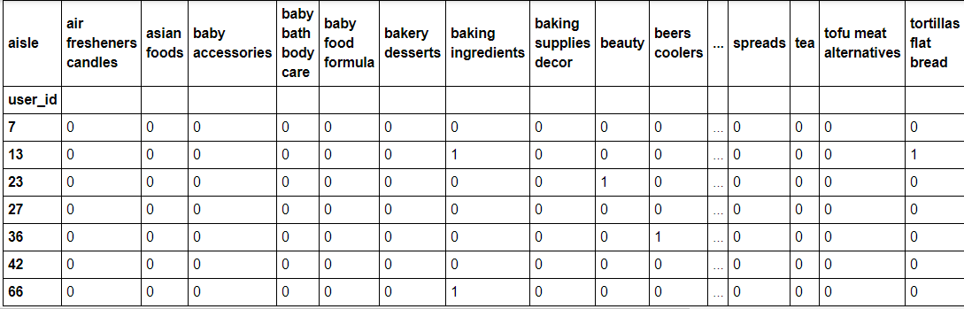
Consumer Segmentation
One of the two approaches we used to study consumer behavior is Consumer Segmentation, using Unsupervised K-Means Clustering. We first transformed the data in the form shown below.
merge= pd.merge(orders_products_prior_df,products_df, on = ['product_id','product_id'])
merge1 = pd.merge(merge,orders_df,on=['order_id','order_id'])
cust_prod = pd.crosstab(merge1['user_id'], merge1['aisle'])
cust_prod
Notes:
There are 134 aisles, which is represented by the the columns in the df shown here. Now to reduce the width of the dataset, we reduce the features for our model, we use Principal Component Analysis. Using PCA, we want to compress our data into some mathematically represented vectors that hold information from all the original features, or most of it.

Slide 25
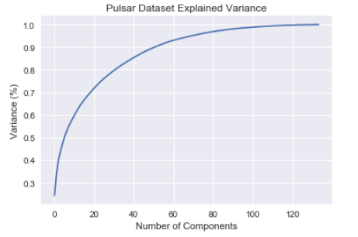
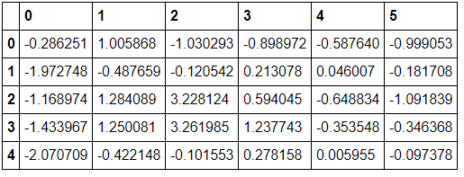
Principal Component Analysis
pca = PCA(n_components =6)
pca.fit(cust_prod)
pca_samples = pca.transform(cust_prod)
OUTCOME:
Notes:
For this purpose, we use this graph to identify how many components we should generate. This graph shows that we should use around 80 components so as to retain 95% variance of our dataset. However, we tried a couple of things and this was still very complicated for the k-means. So for simplicity sake we settled with components that explained around 50% variance from our dataset.

Slide 26
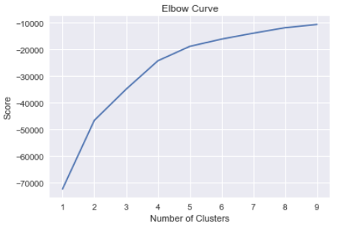
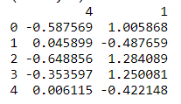
CLUSTERING
Step 1: Identifying the ideal number of clusters using Elbow method
Nc = range(1, 10)
kmeans = [KMeans(n_clusters=i) for i in Nc]
kmeans
score = [kmeans[i].fit(cust_dept).score(cust_dept) for i in range(len(kmeans))]
plt.plot(Nc,score)
plt.xlabel('Number of Clusters')
plt.ylabel('Score')
plt.title('Elbow Curve')
plt.show()
Step 2: Identifying the Principal Components to use
We tried all permutations of PCs to see which components explained the maximum variability and havence give the best distribution of consumers across these segments.
from matplotlib import pyplot as plt
from mpl_toolkits.mplot3d import Axes3D
from mpl_toolkits.mplot3d import proj3d
tocluster = pd.DataFrame(ps[[4,1]])
print (tocluster.shape)
print (tocluster.head())
Notes:
Now the next steps is to use the components that give us the most diverse buckets of consumers. Meaning, the more diverse the consumer segments, the overlap is minimum and we can categorize better and then also build better strategies for each one of them.

Slide 27
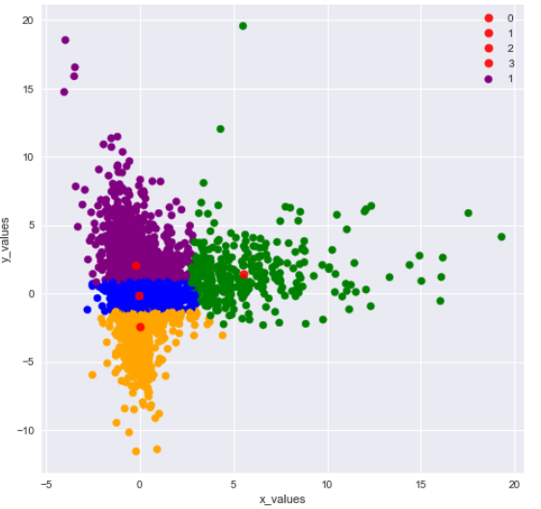
CLUSTERING
Step 3: Running the clustering model
tocluster = pd.DataFrame(ps[[4,1]])
clusterer = KMeans(n_clusters =4, random_state = 42).fit(tocluster)
centers = clusterer.cluster_centers_
c_preds = clusterer.predict(tocluster)
print(centers)

Slide 28
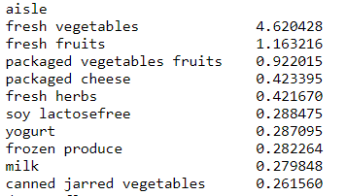
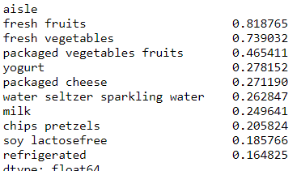
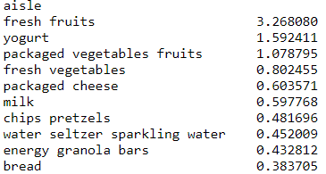
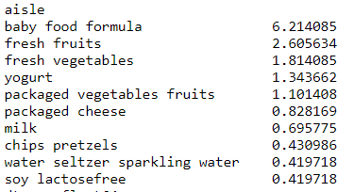
Insights from these segments
Cluster 1:
Cluster 2:
Cluster 3:
Cluster 4:

Slide 29
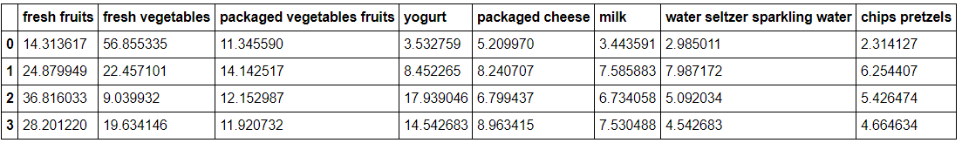
Products which are generically bought by the majority of the customers are:
fresh fruits
fresh vegetables
packaged vegetables fruits
yogurt
packaged cheese
milk
water seltzer sparkling water
chips pretzels
Now, we look at the percentage of these goods with respect to the other top 8 in each cluster.
Notes:
We also notice that clusters have a lot of common items but they differ in quantities and proportions. or if a cluster is characterized by some goods not included in this list. So we look at the most commonly bought items and see how they stand against the other items in that cluster.

Slide 30
APRIORI Algorithm for Association Rule Mining
We are finding Association rules with item sets of size 2, which means if a person buys item1, the item with highest association with it is recommended.
To explain the Association rules, there are three important metrics.
Support: The number of times an order contains the item set. We took minimum support as 0.01, since we have 49000+ products and 3.2 unique orders.
Support= frequency of item/Total no of orders
Confidence: Percentage of orders containing both A&B given that order A is purchased already. Confidence is always between 0 and 1.
Confidence {A->B}= support{A->B}/support{B}
Lift: Lift gives you information about weather the two items are occurring by chance or there is a relationship between both.
Lift{A->B}=Lift{B->A}=Support{A->B}/Support{A}*Support{B}
Notes:
def freq(iterable):
if type(iterable) == pd.core.series.Series:
return iterable.value_counts().rename("freq")
else:
return pd.Series(Counter(iterable)).rename("freq")
# Returns number of unique orders
def order_count(order_item):
return len(set(order_item.index))
# Returns generator that yields item pairs, one at a time
def get_item_pairs(order_item):
order_item = order_item.reset_index().as_matrix()
for order_id, order_object in groupby(order_item, lambda x: x[0]):
item_list = [item[1] for item in order_object]
for item_pair in combinations(item_list, 2):
yield item_pair
def merge_item_stats(item_pairs, item_stats):
return (item_pairs
.merge(item_stats.rename(columns={'freq': 'freqA', 'support': 'supportA'}), left_on='item_A', right_index=True)
.merge(item_stats.rename(columns={'freq': 'freqB', 'support': 'supportB'}), left_on='item_B', right_index=True))
# Returns name associated with item
def merge_item_name(rules, item_name):
columns = ['itemA','itemB','freqAB','supportAB','freqA','supportA','freqB','supportB',
'confidenceAtoB','confidenceBtoA','lift']
rules = (rules
.merge(item_name.rename(columns={'item_name': 'itemA'}), left_on='item_A', right_on='item_id')
.merge(item_name.rename(columns={'item_name': 'itemB'}), left_on='item_B', right_on='item_id'))
return rules[columns]

Slide 31
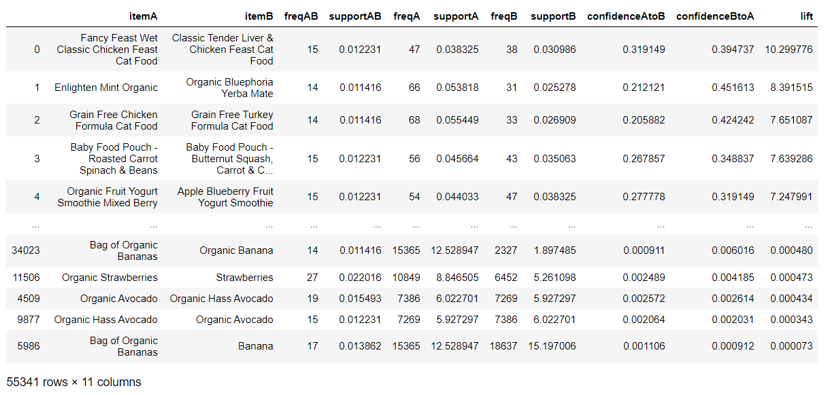
APRIORI Algorithm for Association Rule Mining
Notes:
def association_rules(order_item, min_support):
print("Starting order_item: {:22d}".format(len(order_item)))
# Calculate item frequency and support
item_stats = freq(order_item).to_frame("freq")
item_stats['support'] = item_stats['freq'] / order_count(order_item) * 100
# Filter from order_item items below min support
qualifying_items = item_stats[item_stats['support'] >= min_support].index
order_item = order_item[order_item.isin(qualifying_items)]
print("Items with support >= {}: {:15d}".format(min_support, len(qualifying_items)))
print("Remaining order_item: {:21d}".format(len(order_item)))
# Filter from order_item orders with less than 2 items
order_size = freq(order_item.index)
qualifying_orders = order_size[order_size >= 2].index
order_item = order_item[order_item.index.isin(qualifying_orders)]
print("Remaining orders with 2+ items: {:11d}".format(len(qualifying_orders)))
print("Remaining order_item: {:21d}".format(len(order_item)))
# Recalculate item frequency and support
item_stats = freq(order_item).to_frame("freq")
item_stats['support'] = item_stats['freq'] / order_count(order_item) * 100
# Get item pairs generator
item_pair_gen = get_item_pairs(order_item)
# Calculate item pair frequency and support
item_pairs = freq(item_pair_gen).to_frame("freqAB")
item_pairs['supportAB'] = item_pairs['freqAB'] / len(qualifying_orders) * 100
print("Item pairs: {:31d}".format(len(item_pairs)))
# Filter from item_pairs those below min support
item_pairs = item_pairs[item_pairs['supportAB'] >= min_support]
print("Item pairs with support >= {}: {:10d}\n".format(min_support, len(item_pairs)))
# Create table of association rules and compute relevant metrics
item_pairs = item_pairs.reset_index().rename(columns={'level_0': 'item_A', 'level_1': 'item_B'})
item_pairs = merge_item_stats(item_pairs, item_stats)
item_pairs['confidenceAtoB'] = item_pairs['supportAB'] / item_pairs['supportA']
item_pairs['confidenceBtoA'] = item_pairs['supportAB'] / item_pairs['supportB']
item_pairs['lift'] = item_pairs['supportAB'] / (item_pairs['supportA'] * item_pairs['supportB'])
# Return association rules sorted by lift in descending order
return item_pairs.sort_values('lift', ascending=False)

Slide 32
5
RECOMMENDATIONS

Slide 33
RECOMMENDATIONS
1
When the customer adds products to the cart, we can suggest products that he/she could buy along with the product that has already been added to the cart. For this, we are using APIORI.
2
With a returning customer, we can use segmentation to classify the customer into a particular cluster and suggest the products based on the cluster in which the user has been put into.
3
With a new customer, we can suggest products that are purchased most frequently by majority of the users from the store.

Slide 34
RECOMMENDATIONS
4
With returning customer, we could also suggest products for purchase that were frequently purchased by the customer and also suggest most frequently bought items by customers across the store
We could also pre-add products to the basket of a customer (i.e. before he/she starts adding products to the basket) based on the customer’s previous purchase, to make the purchase experience quick and easy.
5
6
For every product that we recommend, we will consider it as a success if the user ends up purchasing the recommended product. So, the success can be calculated by accuracy.
Notes:
Accuracy for an order = no. of recommended products purchased / total no. of recommended products
Final accuracy = mean of accuracy of all the orders

Slide 35
Q&A
Thank You!

Slide 36
Thank You!
Thank You!

